Slide 1

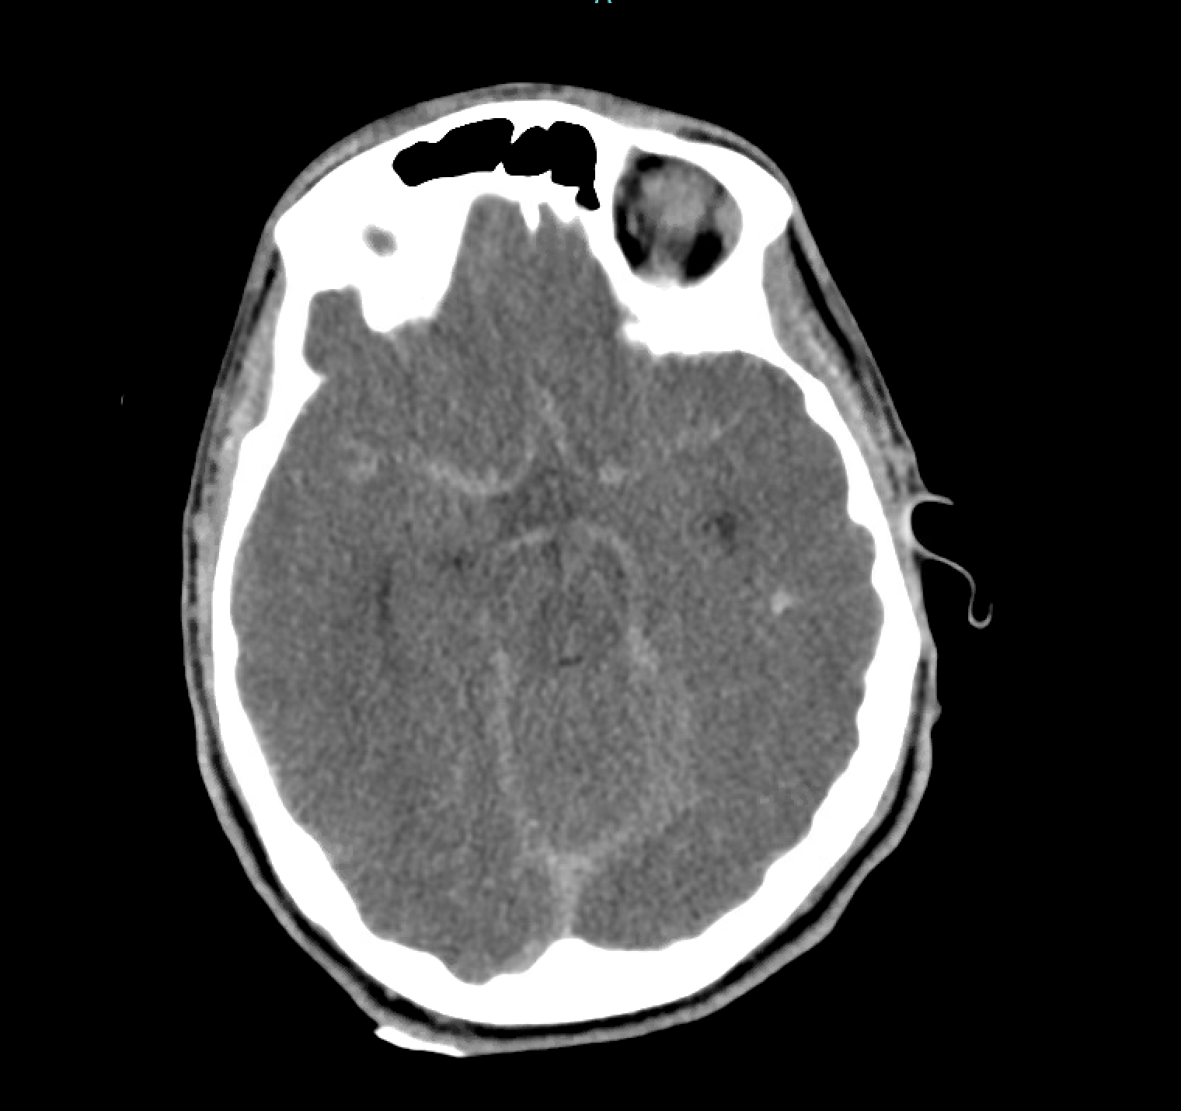
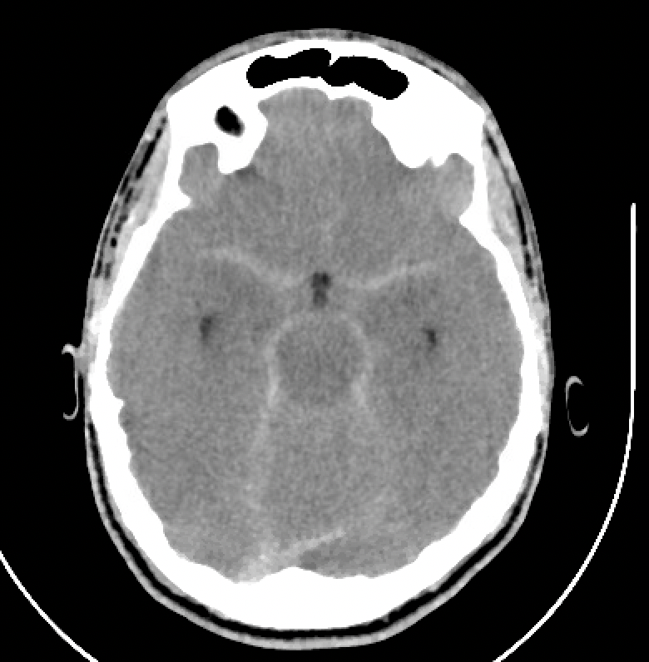

Ethylene Glycol Poisoning Complicated by Cerebral Edema - Is Hemodialysis Safe?
Kathryn Kimpel MD^{1,2}, Louise Kao MD^{1,2}
¹Indiana University School of Medicine, Indianapolis, IN, USA. ²Indiana Poison Center, Indianapolis, IN, USA
Background
Figure 1
Figure 2
Discussion
Hemodialysis (HD) is crucial treatment for severe ethylene glycol (EG) poisoning. EG toxicity is also associated with cerebral edema. We present a patient with severe EG toxicity who had evidence of cerebral edema and received HD, with a poor outcome.
Figure 1: Head CT prior to initiation of HD. Shows global effacement of cerebral sulci and basal cisterns, concerning for cerebral edema and elevated ICP.
Figure 2: Head CT post arrest showing pseudosubarachnoid hemorrhage, indicative of worsening cerebral edema, elevated ICP, and hypoxic injury, no definitive herniation.
HD can exacerbate cerebral edema through dialysis disequilibrium syndrome caused by rapid removal of urea.
Additionally, a rapid rise in serum pH with HD can cause a paradoxical increase in intracellular acidosis, worsening cerebral edema.
However, HD is the treatment of choice for severe EG toxicity and can be lifesaving.
In this case, the patient’s decompensation may have been related to worsening cerebral edema.
Further investigation is needed regarding the use of HD in poisoned patients with cerebral edema.
Case presentation
17-year-old male presented unresponsive, last seen well 19 hours prior.
Initial Vitals: T 36.2C, HR 101, RR 29, BP 145/97, SpO2 98% on RA
PE: Dry mucus membranes, GCS 8, no focal deficits.
Initial labs: pH 6.90, HCO₃ <10 mEq/L, pCO₂ 18 mmHg, K 6.6 mEq/L, Cr 1.81 mg/dL, and osmolar gap 42 mOsm/kg.
A lactate gap was noted: VBG lactate >16 mmol/L, serum lactate 3.3 mmol/L. CT head was unremarkable.
He was intubated, given calcium gluconate, insulin/dextrose and started on bicarbonate infusion
Transferred to a tertiary care facility.
Hospital Course
Patient’s clinical and laboratory picture suggested EG toxicity.
Therapy was initiated with fomepizole, thiamine, and pyridoxine; nephrology was consulted for urgent HD.
Repeat head CT ~38 hours after last seen well showed global effacement of cerebral sulci and basal cisterns, concerning for cerebral edema (Figure 1).
Hypertonic saline was added to bicarbonate infusion and HD was initiated ~41 hours after last seen well.
Approximately 20-30 minutes after initiation of HD, patient became hypertensive to 200s/100s and HR dropped from 110s to 70s.
Pupils were dilated and non-reactive, prompting concern for herniation. Patient became pulseless with asystole.
After 10 minutes, ROSC achieved after epinephrine, lidocaine, calcium, and mannitol.
Repeat head CT (Figure 2) with pseudosubarachnoid hemorrhage, worsening cerebral edema, no definitive herniation.
Post-arrest, patient had no cough or gag; pupils remained fixed and dilated.
Family ultimately decided to withdraw care and patient passed away.
After five days, EG level resulted 59.1 mg/dL, drawn ~27 hours after last seen well.

